Slide 1
Pointer

Slide 2
Pointer Variable
Memory address
Every variable in a program is stored in the RAM(memory) at some location specified by the memory address
Which can be checked by &var_name
Pointer variable
stores starting memory address of some variable
count
7
countPtr
count
7

Slide 3
Pointer declaration
* indicates variable is pointer
int *myPtr;
declares pointer to int
Multiple pointers can be declared in one line
int *myPtr1, *myPtr2;

Slide 4
Pointer Operators
& (address operator)
Returns starting memory address of its operand
Example
int y = 5; int *yPtr; yPtr = &y; // yPtr gets address of y
yPtr “points to” y
y
yptr
y
yPtr
5
500000
600000
600000
5
address of y is value of yptr

Slide 5
Pointer Operators
* (indirection/dereferencing operator)
Data that pointers points to
*yPtr returns value in y (because yPtr points to y).
dereferenced pointer
*yptr = 9; // assigns 9 to y
* and & are inverses of each other

Slide 6
y
yptr
y
yPtr
5
500000
600000
600000
5
address of y is value of yptr
What will be printed
cout<<yptr;
cout<< &yptr;
cout<< *yptr;
600000
500000
5

Slide 7
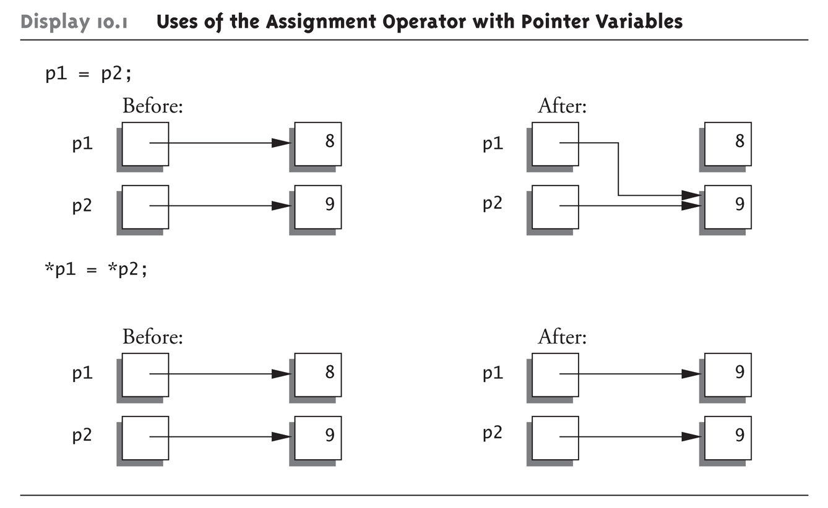
Uses of the Assignment Operator with Pointer Variables

Slide 8
Pointer Type
Can declare pointers to any data type, e.g.,
char* ptr
int* ptr
float* ptr
struct student* ptr
What is the size of pointer in memory?
What ever the pointer type is, it always take 4 bytes of memory
Because it always store just the address of the first byte of a variable, it points to.
Why we need to specify the type of pointer???
(discussed at the end)

Slide 9
Pointer Type
Pointer occupies 4bytes, whatever the type of the pointe is
Incrementing a pointer
A pointer is usually incremented when dealing with pointers pointing an array
Pointer can be incremented in two ways
Pointer++
Pointer+i
A pointer jumps through as many addresses, as the type of pointer is:
4bytes for int
1byte for char
8 bytes for double

Slide 10
Pointer Types
int main()
{
char str[30]="Programming Fundamentals";
char *p=str;
for(int i=0;i<strlen(str);i++)
{
cout<<*p;
p++;
}
return 0;
}
Answer: Programming Fundamentals
int main()
{
char str[30]="Programming Fundamentals";
int *p=(int*)str;
for(int i=0;i<6;i++)
{
cout<<(char)*p;
p++;
}
return 0;
}
Answer:
PriFat

Slide 11
Pointer Application
Pointer are extensively used in C++. Main areas, where pointers are used are
Pointer to Arrays
Pointers as Function Argument and as Return value
Dynamic Memory Allocation
File handling

Slide 12
Pointer and Arrays
main()
{
int a[2]={44,55};
int *ptr = &a;
//print the array elements
cout<< a[0]<<“\n”<< a[1];
cout<< *ptr << “\n” << *(ptr+1);
cout<< ptr[0] << “\n” << ptr[1];
cout<< *a << “\n” << *(a+1);
}
Arrays are also a kind of pointer.
Pointer can be used to access array elemnts
And pointers can be used with array notation.
Array name can be used with pointer notation,

Slide 13
Arrays and pointers
int a[]={40,50,60,70,80};
int *ptr = &a;
for(int i=0;i<5;i++)
cout << *( ptr + i ) << “\t”;
//Output: 40 50 60 70 80
for(int i=0;i<5;i++)
cout << *ptr + i << “\t”;
//Output: 40 41 42 43 44

Slide 14
Back to Functions
When we pass arguments with function call, e.g.,
func(int)
Then there are two ways to do so
Pass by value
Pass by reference

Slide 15
Pass by Value - Pass by Reference - Pass by Pointer
void f(int n)
{
n++;
}
int main()
{
int x = 2;
f(x);
cout << x;
}
void f(int &n)
{
n++;
}
int main()
{
int x = 2;
f(x);
cout << x;
}
void f(int *n)
{
*n++;
}
int main()
{
int x = 2;
f(&x);
cout << x;
}
Output: 2
Output: 3
Output: 3

Slide 16
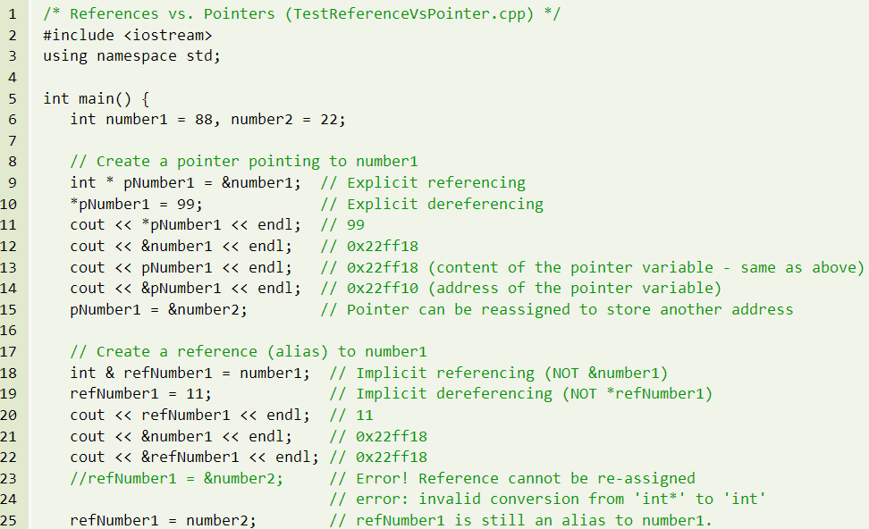
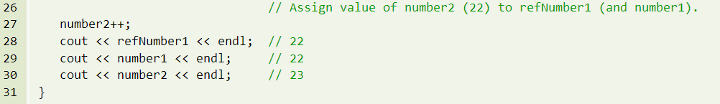

Slide 17
Pass by value vs Pass by pointer
void func(int, int);
main()
{
int a=2, b=4;
func(a,b);
cout<<a<<“ “<<b;
}
void func(int c, int d)
{
c=10;
d=12;
}
void func(int*, int*);
main()
{
int a=2, b=4;
func(&a,&b);
cout<<a<<“ “<<b;
}
void func(int *c, int *d)
{
*c=10;
*d=12;
}

Slide 18
Pointer as return type
Pointer can be used as a return type as well.
For Example
int* myFunction();
Caution:
Never return the address of local variable

Slide 19
Error
int* myFunction( )
{
int b = 10;
retrun &b;
} // scope of b ends here
int main( )
{
int *x;
x = myFunction( );
// x pointing to location not now part of the program
}

Slide 20
Returning from a function
A function can return only one value
But what if we want to return more than one values
We can do so by using pass by reference or pass by pointer

Slide 21
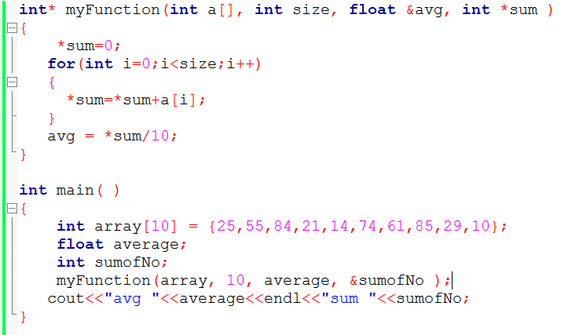

Slide 22
Memory Allocation
Static Memory Allocation
Memory is allocated at compilation time
Dynamic Memory Allocation
Memory is allocated at running time

Slide 23
Static vs. Dynamic Memory Allocation
Static allocation
(variables as declared in function calls)
Memory is acquired automatically
Memory is returned automatically when object goes out of scope
Dynamic allocation
Memory is acquired by program with an allocation request
new operation
Dynamic objects can exist beyond the function in which they were allocated
Object memory is returned by a deallocation request
delete operation

Slide 24
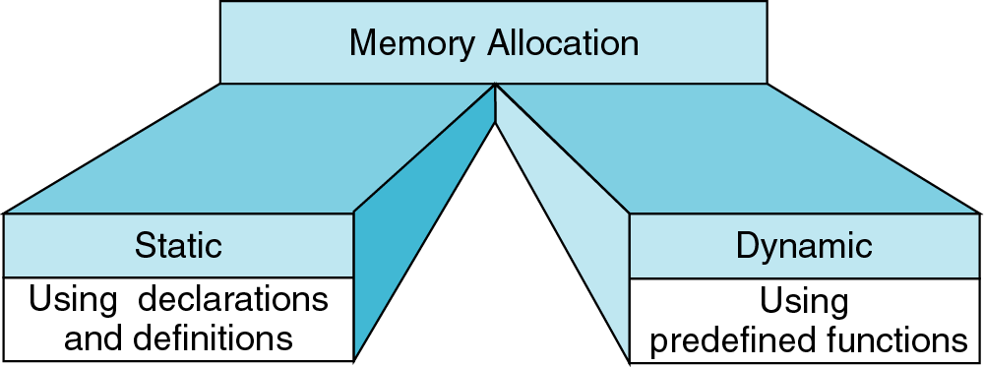
Memory Allocation
new
delete
{
int a[200];
…
}
int* ptr;
ptr = new int[200];
…
delete [] ptr;

Slide 25
Object (variable) creation: New
Syntax
ptr = new SomeType;
where ptr is a pointer of type SomeType
Example
int* p = new int;
Uninitialized int variable
p

Slide 26
Object (variable) destruction: Delete
Syntax
delete p;
storage pointed to by p is returned to free store and p is now undefined
Example
int* p = new int;
*p = 10;
delete p;
p
10

Slide 27
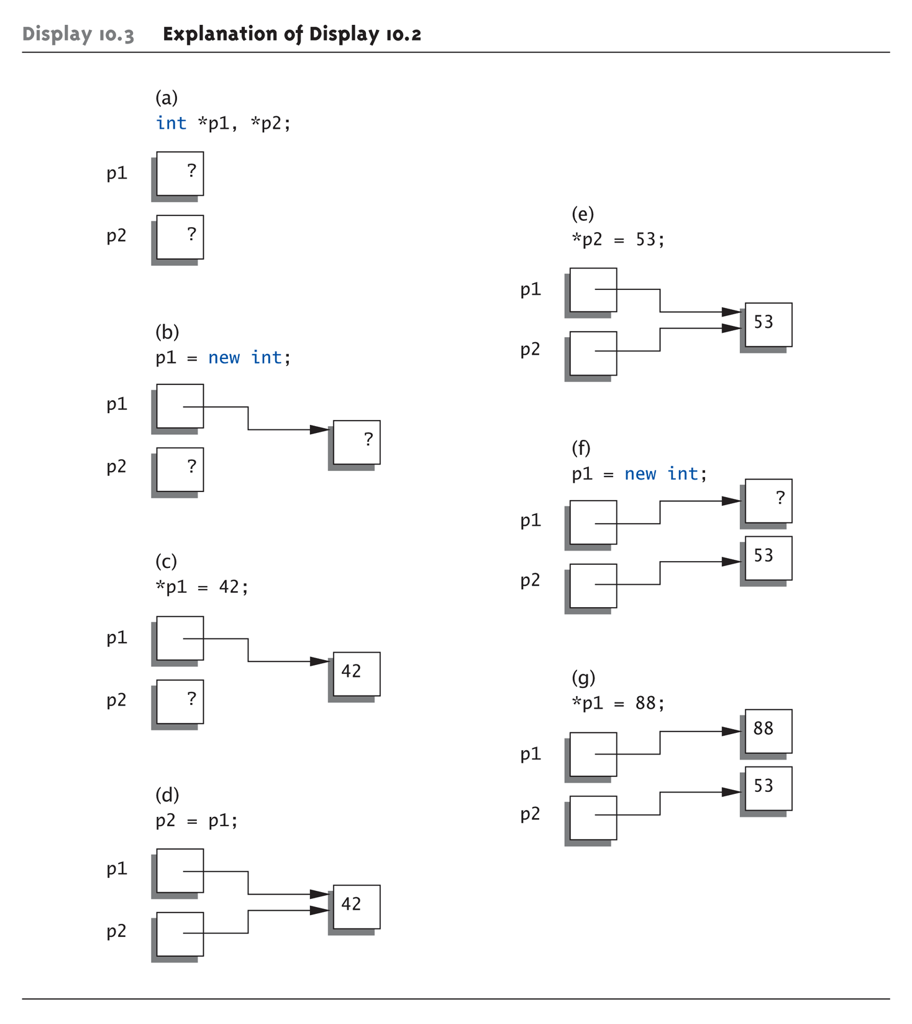
Basic Pointer Manipulations

Slide 28
Array of New: dynamic arrays
Syntax
P = new SomeType[Expression];
Where
P is a pointer of type SomeType
Expression is the number of objects to be constructed -- we are making an array
Because of the flexible pointer syntax, P can be considered to be an array

Slide 29
Example
Dynamic Memory Allocation
Request for “unnamed” memory from the Operating System
int *p, n=10; p = new int;
p = new int[100];
new
p
new
p
new
p = new int[n];
p

Slide 30
Memory Allocation Example
Want an array of unknown size
#include <iostream>
using namespace std;
void main()
{
int n;
cout << “How many students? “;
cin >> n;
int *grades = new int[n];
for(int i=0; i < n; i++){
int mark;
cout << “Input Grade for Student” << (i+1) << “ ? :”;
cin >> mark;
grades[i] = mark;
}
. . .
printMean( grades, n ); // call a function with dynamic array
. . .
}

Slide 31
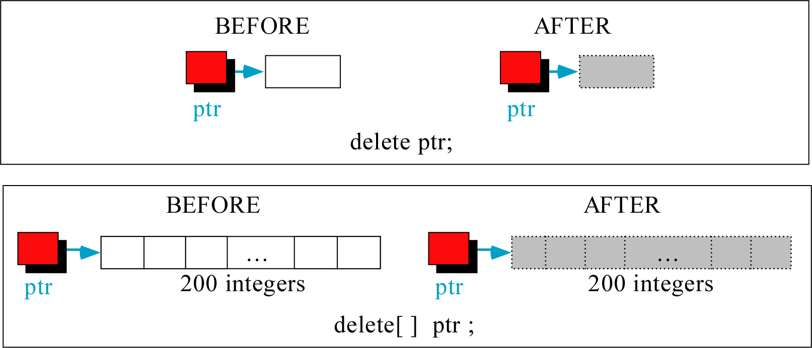
Freeing (or deleting) Memory

Slide 32
Dynamic variables: new & delete
C++ keywords:
new //create new var; reserve space
delete //storage created is //returned to free store
Example
delete p;
delete [] name;
int* p = new int;
*p = 10;
delete p;
*p
dangling pointer
X
p

Slide 33
Dangling Pointers
delete p;
Destroys dynamic memory
But p still points there!
Called "dangling pointer"
If p is then dereferenced ( *p )
Unpredicatable results!
Often disastrous!
Avoid dangling pointers
Assign pointer to NULL after delete: delete p; p = NULL;

Slide 34
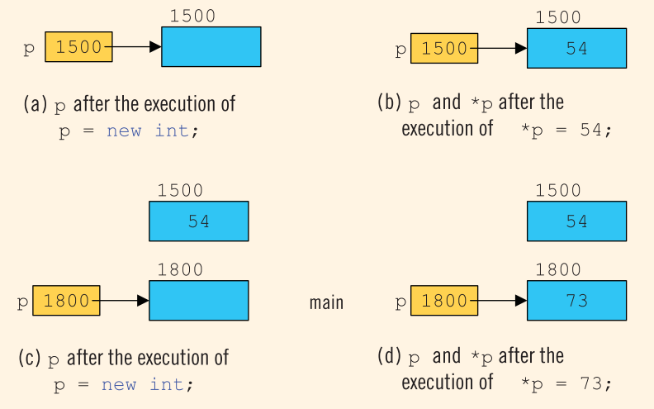
Memory Leak
memory leak

Slide 35
Accessing dynamically created space
So once the space has been dynamically allocated, how do we use it?
For single items, we go through the pointer. Dereference the pointer to reach the dynamically created target:
int *p = new int;//dynamic integer, pointed to by p
*p = 10; // assigns 10 to the dynamic integer
cout << *p; // prints 10

Slide 36
Accessing dynamically created space
For dynamically created arrays, you can use either
pointer-offset notation, or
treat the pointer as the array name and use the standard bracket notation:
double * numList = new double[size]; // dynamic array
for (int i = 0; i < size; i++)
numList[i] = 0; // initialize array elements to 0
numList[5] = 20; // bracket notation
*(numList + 7) = 15; // pointer-offset notation
// means same as numList[7]

